Slide 1
Session Tracking Mechanism - Cookies

Slide 2
What is Cookie?
A cookie
small piece of information that is persisted between the multiple client requests
A cookie has name and value
Optional attributes
Comment
Path
Domain qualifiers
Maximum age
Version number

Slide 3
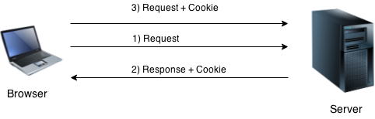
How Cookie works?
By default, each request is considered as a new request
Cookie is added with response from the servlet
Cookie is stored in the cache of the browser
Request is sent by the user, cookie is added with request by default
Recognize the user as the old user.

Slide 4
Type of Cookies
Two types of cookies
Non-persistent cookie
Persistent cookie
Non-persistent cookie
valid for single session only
removed each time when user closes the browser
Persistent cookie
valid for multiple sessions
not removed each time when user closes the browser
It is removed only if user logout or signout.

Slide 5
Advantages & Disadvantages
Advantage of Cookies
Simplest technique of maintaining the state
Cookies are maintained at client side
Disadvantage of Cookies
It will not work if cookie is disabled from the browser
Only textual information can be set in Cookie object

Slide 6
Constructors & Methods
Constructor | Description
Cookie() | constructs a cookie.
Cookie(String name, String value) | constructs a cookie with a specified name and value.
Method | Description
public void setMaxAge(int expiry) | Sets the maximum age of the cookie in seconds.
public String getName() | Returns the name of the cookie. The name cannot be changed after creation.
public String getValue() | Returns the value of the cookie.
public void setName(String name) | changes the name of the cookie.
public void setValue(String value) | changes the value of the cookie.

Slide 7
Creation and Deletion of Cookies
How to create Cookie?
Cookie ck=new Cookie("user","sonoo jaiswal");//creating cookie object
response.addCookie(ck);//adding cookie in the response
How to delete Cookie?
Cookie ck=new Cookie("user","");//deleting value of cookie
ck.setMaxAge(0);//changing the maximum age as 0
response.addCookie(ck);//adding cookie in the response

Slide 8
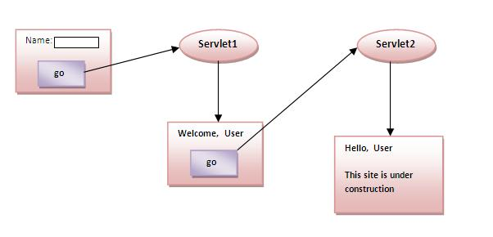
How to get Cookies?
Cookie ck[]=request.getCookies();
for(int i=0;i<ck.length;i++)
{
out.print("<br>"+ck[i].getName()+" "+ck[i].getValue());
}
Storing the name of the user in the cookie object and accessing it in another servlet

Slide 9
Cookie Example1 – web.xml
<servlet>
<servlet-name>s2</servlet-name>
<servlet-class>SecondServlet</servlet-class>
</servlet>
<servlet-mapping>
<servlet-name>s2</servlet-name>
<url-pattern>/servlet2</url-pattern>
</servlet-mapping>
</web-app>
<web-app>
<servlet>
<servlet-name>s1</servlet-name>
<servlet-class>FirstServlet</servlet-class>
</servlet>
<servlet-mapping>
<servlet-name>s1</servlet-name>
<url-pattern>/servlet1</url-pattern>
</servlet-mapping>

Slide 10
Cookie Example1 – FirstServlet
public class FirstServlet extends HttpServlet {
public void doPost(HttpServletRequest request, HttpServletResponse response){
try{
response.setContentType("text/html");
PrintWriter out = response.getWriter();
String n=request.getParameter("userName");
out.print("Welcome "+n);
Cookie ck=new Cookie("uname",n);//creating cookie object
response.addCookie(ck);//adding cookie in the response
//creating submit button
out.print("<form action='servlet2'>");
out.print("<input type='submit' value='go'>");
out.print("</form>");
out.close();
}catch(Exception e){System.out.println(e);}
}
}

Slide 11
Cookie Example1 – SecondServlet
public class SecondServlet extends HttpServlet {
public void doPost(HttpServletRequest request, HttpServletResponse response){
try{
response.setContentType("text/html");
PrintWriter out = response.getWriter();
Cookie ck[]=request.getCookies();
out.print("Hello "+ck[0].getValue());
out.close();
}catch(Exception e){System.out.println(e);}
}
}

Slide 12
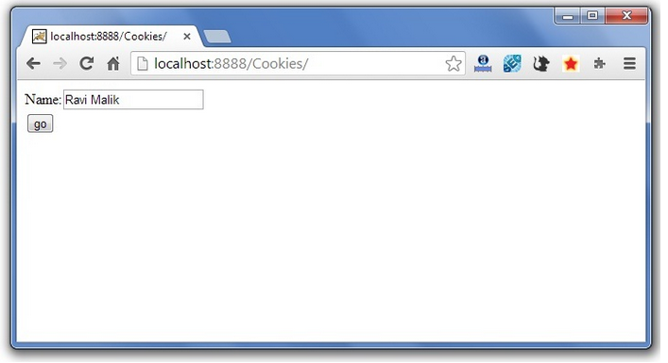
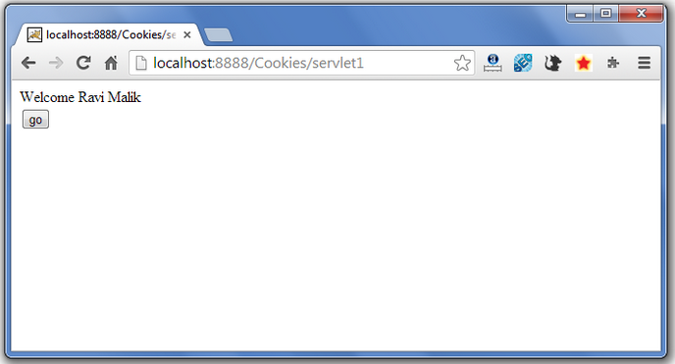
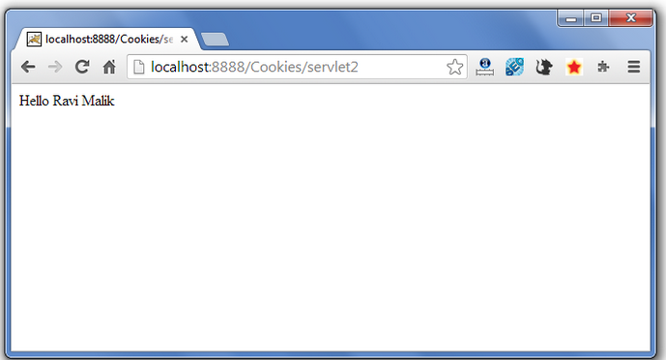
Cookie Example1 – SecondServlet
Index.html
<form action="servlet1" method="post">
Name:<input type="text" name="userName"/><br/>
<input type="submit" value="go"/>
</form>

Slide 13
Cookie Example2 – Setting Cookies
public void doGet(...) {
response.setContentType("text/html");
PrintWriter out = response.getWriter();
// Create cookies for first and last names.
Cookie firstName = new Cookie("first_name“, request.getParameter("first_name"));
Cookie lastName = new Cookie("last_name“, request.getParameter("last_name"));
// Set expiry date after 24 Hrs for both the cookies.
firstName.setMaxAge(60*60*24);
lastName.setMaxAge(60*60*24);
// Add both the cookies in the response header.
response.addCookie( firstName );
response.addCookie( lastName );
String title = "Setting Cookies Example";
String docType =
"<!doctype html public \"-//w3c//dtd html 4.0 " +
"transitional//en\">\n";
out.println(docType +
"<html>\n" +
"<head><title>" + title + "</title></head>\n" +
"<body bgcolor=\"#f0f0f0\">\n" +
"<h1 align=\"center\">" + title + "</h1>\n" +
"<ul>\n" +
" <li><b>First Name</b>: "
+ request.getParameter("first_name") + "\n" +
" <li><b>Last Name</b>: "
+ request.getParameter("last_name") + "\n" +
"</ul>\n" +
"</body></html>");}}

Slide 14
Cookie Example2 – Setting Cookies
public class ReadCookies extends HttpServlet {
public void doGet(...)
{
Cookie cookie = null;
Cookie[] cookies = null;
// Get an array of Cookies associated with this domain
cookies = request.getCookies();
// Set response content type
response.setContentType("text/html");
PrintWriter out = response.getWriter();
String title = "Reading Cookies Example";
String docType =
"<!doctype html public \"-//w3c//dtd html 4.0 " +
"transitional//en\">\n";
out.println(docType +
"<html>\n" +
"<head><title>" + title + "</title></head>\n" +
"<body bgcolor=\"#f0f0f0\">\n" );
if( cookies != null ){
out.println("<h2> Found Cookies Name and Value</h2>");
for (int i = 0; i < cookies.length; i++)
{
cookie = cookies[i];
out.print("Name : " + cookie.getName( ) );
out.print("Value: " + cookie.getValue( ));
}
}else{
out.println(
"<h2>No cookies founds</h2>");
}
out.println("</body>");
out.println("</html>");
}
}

Slide 15
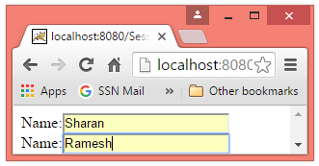
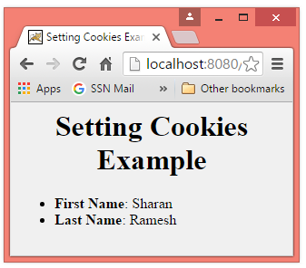
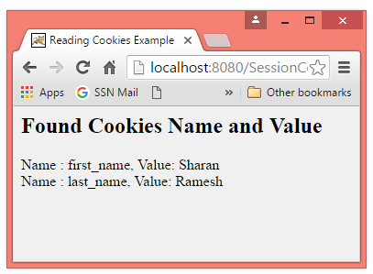
Cookie Example2 - Output
Index.html
<form action="hello" method="get">
Name:<input type="text" name="first_name"/><br/>
Name:<input type="text" name="last_name"/><br/>
<input type="submit" value="go"/>
</form>

